Slide 1
How do we use scatter graphs?
We can use scatter graphs to estimate results based upon other results. We do this by drawing a "line of best fit".
A "line of best fit" is a straight line (drawn with a ruler) that goes through the middle of your points. This is an estimate, but try to get half of the points on either side of it.
The "line of best fit" does not have to go through the origin!
When doing an estimate from a scatter graph you must draw the "line of best fit" or you will get no marks!
If there is no correlation, you cannot draw a "line of best fit".

Slide 2
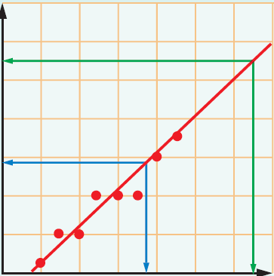
How can I make a prediction from a Scatterplot?
A line of best fit is a line that shows the general pattern of points on a graph.
Interpolation is the prediction of a value within the range of data.
Extrapolation is the prediction of a value outside the range of the data.
5

Slide 3
Try this question
Imogen missed the Science test because she was ill.
She sat the Maths test and got 85.
Use your scatter graph to estimate what Imogen would have achieved on the Science test.
100
90
80
70
60
Science mark
50
40
30
20
10
0
10
20
30
40
50
60
70
80
90
100
Maths mark

Slide 4
Imogen missed the Science test because she was ill.
She sat the Maths test and got 85.
Use your scatter graph to estimate what Imogen would have achieved on the Science test.
What about Gertrude? She scored 10% in maths, what would you predict she might get in science?
100
90
80
70
Imogen would have got 83.
60
Science mark
50
40
Gertrude would have got 15%
30
20
10
0
10
20
30
40
50
60
70
80
90
100
Maths mark

Slide 5
Estimate, using your graph, how many scarves the shop would sell when the temperature was 7ºC.
How about at 3ºC?
Which is interpolation and which is extrapolation?
Estimate, using your graph, how many litres of petrol the car would use on a journey of 160km.
How about at 5min?
Which is interpolation and which is extrapolation?
20
25
20
15
15
Temperature (ºC)
Petrol used (l)
10
10
5
5
0
10
20
30
40
50
60
70
80
90
100
0
20
40
60
80
100
120
140
160
180
200
Sales of scarves
Distance (km)

Slide 6
Estimate, using your graph, how many scarves the shop would sell when the temperature was 7ºC.
How about at 3ºC?
Which is interpolation and which is extrapolation?
Estimate, using your graph, how many litres of petrol the car would use on a journey of 160km.
How about at 5min?
Which is interpolation and which is extrapolation?
20
25
20
15
15
Temperature (ºC)
Petrol used (l)
10
10
5
5
0
10
20
30
40
50
60
70
80
90
100
0
20
40
60
80
100
120
140
160
180
200
Sales of scarves
Distance (km)
Answer: 80 scarves and 100 scarves – the prediction at 3ºc is extrapolation
Answer: 15 litres and 1.5L the prediction of 1.5L is extrapolation

